Slide 1
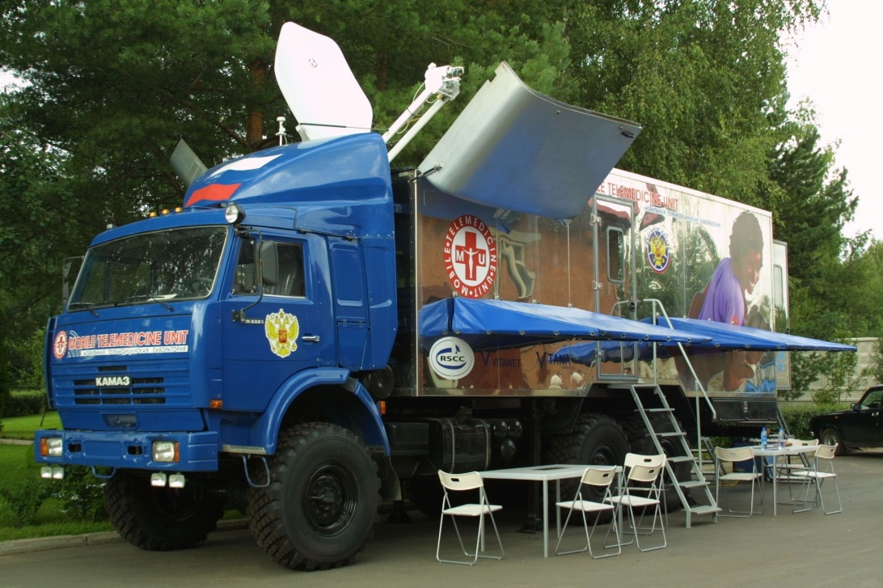
Establishment of TatTeleMed Ltd.
for Mobile Telemedicine Complexes production
in Industrial park "Chistopol"
2019

Slide 2
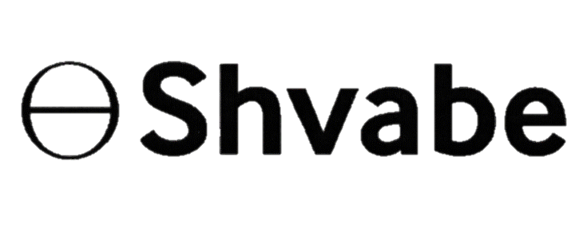
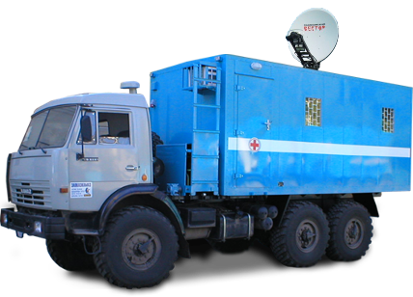
On the Mobile Telemedicine Complex
The KAMA Mobile Telemedicine Complex (MTC) allows on-line automated fluorographic studies (basic project element, mammography and/or cardiography options) necessary for effective mass screening of public health including those who live in rural and hard-to-reach areas during periodic health and preventive examinations.
Data exchange with Artificial Medical Intelligence (AMI) in analysis of fluorography images located in the cloud is carried out using a telecommunications module installed in the MTC.
ESV
Satellite channel
AMI
in analysis of fluorography images
Cellular base station
4G radio line
4G router with automatic switching to the satellite communication system in the absence of 4G signal
2

Slide 3
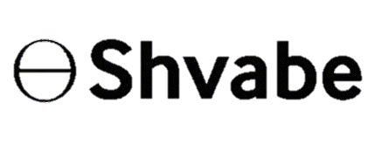
On TatTeleMed Ltd.
Advantages of Industrial Park "Chistopol"
Benefits description | Percent
Profit tax | 5% per first five years 12% per subsequent years
Insurance premium | 7.6 %
Property tax | 0 %
Land tax | 0 %
66.6%
33.4%
3

Slide 4
Market
In accordance with the Decree of the President of the Russian Federation No. 204 dated May 7, 2018 “On the National Development Goals and Strategic Objectives of the Russian Federation in the Period until 2024”, the National Health Project and the Russian Government program on transition to digital health as an essential component of the digital economy , it is necessary to ensure general availability and the single high standard of healthcare quality, primarily in rural areas. And for distant and hard-to-reach areas, it was decided to use Mobile Telemedicine Complexes (hereinafter referred to as MTC) including fluorography, mammography, combined ones, FAS, etc.
For information: more than 2 trillion rubles in total will be provided for the National Health Project.
MTC are intended for work in 100 thousand settlements with total number of about 33 million people. It is proposed to connect MTC to the telemedicine center that comprises the “necklace” of artificial medical intellects (fluorography, mammography, etc.).
With the help of the President of the Republic of Tatarstan R.N. Minnikhanov, we propose to receive a state order for 800 telemedicine complexes for production arrangement in the Industrial Park "Chistopol". According to our estimates, the state order will bring a net profit of 850 million rubles with a gross income of 13.4 billion rubles. It will allow to create a modern ongoing production with high export potential.
The use of MTC and telecommunications module will allow providing remote diagnostics of patients without the presence of a high-class doctor directly at the place of examination (in this case, it could be a medical assistant) based on application of on-line medical data processing cloud service.
4

Slide 5
High-technology non-resource export to Asia, Africa, Latin America and Oceania in accordance with the recommendations of the UN, WHO and ITU
BRICS countries: ACP countries: CIS countries:
China 17,000 pcs. Morocco 3,000 pcs. Uzbekistan 1,500 pcs.
India 15,000 pcs. Algeria 2,500 pcs. Armenia 500 pcs.
Brazil 10,000 pcs. Ghana 1,500 pcs. Kyrgyzstan 500 pcs.
RSA 7,000 pcs.
5

Slide 6
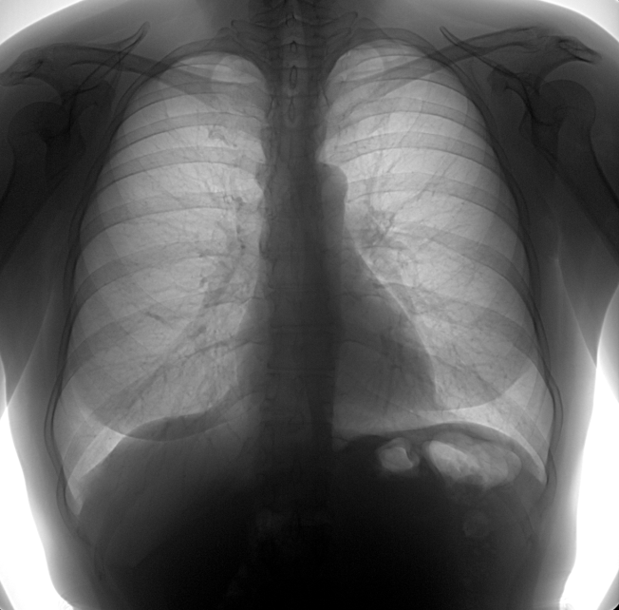
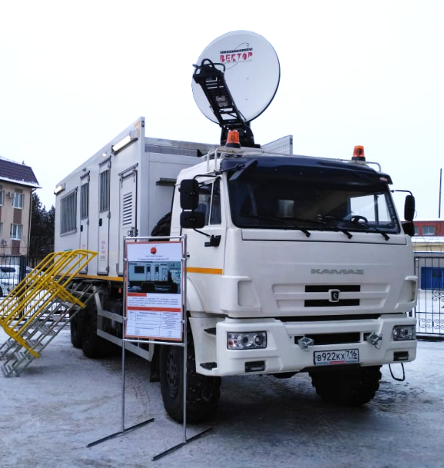
Out advantages
The MTC is provided with a complete set of design documentation. The development of process documentation for KAMA MTC production using our know-how - Lego-technology during the manufacture of modern equipment.
The artificial medical intelligence developed in our company is our know-how (patent of invention No. 2684181), installed in the KAMA MTC provides for the best quality of fluorograms analysis in Russia, without destroying the existing system of fluorography by reducing the human error and reducing time of images analysis (0.8 s) with the high quality.
Our company has wide experience in creating mobile satellite communications complexes, including for the Government of the Republic of Tatarstan, the Ministry of Emergency Situations and the Ministry of Internal Affairs of the Republic of Tatarstan, the Ministry of Internal Affairs of the Republic of Chuvashia, for oil companies Rosneft and Lukoil, as well as for the legendary team of KAMAZ-Master. Our specialists develop, build and train in operation of mobile complexes of any complexity.
6

Slide 7
Main Suppliers
KAMAZ
truck
KAMAZ PTC, Tatarstan
Automated fluorograms analysis software
RC Vector JSC
Tatarstan
Homing satellite communication system
Viscom LLC
Moscow
Body unified zero (normal) size
TNG-Universal LLC
Tatarstan
Fluorograph
Aktub Rentgen LLC
Moscow
Engineering systems equipment
ETM LLC
Tatarstan
Hardware-software complex
ICL Group
Tatarstan
KAMA MTC
7

Slide 8
Delivery plan
Year | Month | Name | Customer
2019 | August - December 5 months | Delivery of 12 complexes | Minister of Industry and Trade of the Russian Federation
2020 | 12 months | Delivery of 156 complexes | Minister of Industry and Trade of the Russian Federation
2021 | 12 months | Delivery of 239 complexes | Minister of Industry and Trade of the Russian Federation
2022 | 12 months | Delivery of 240 complexes | Minister of Industry and Trade of the Russian Federation
2023 | 7 months (12 months) | Delivery of 151 complexes (240 complexes in total are manufactured for just 12 months) | Minister of Industry and Trade of the Russian Federation (Export)
8

Slide 9
Project summary
Sales | 2019-2023
Total investment costs, including: | 240,000 | thous. rub.
Buildings, structures, etc. | 90,000 | thous. rub.
Equipment | 13,267 | thous. rub.
Intangible assets | 40,000 | thous. rub.
Investments in stock additions | 88б733 | thous. rub.
Funding:
Proprietary funds: | 40,000 (17%) | thous. rub.
Borrowed funds: | 200,000 (83%) | thous. rub.
Project capacity (KAMA MTC): | 240 | pcs. per annum
Annual average*: | 3,126,390 | thous. rub.
Annual average net profit*: | 116,618 | thous. rub.
Annual average profitability of sales | 4.64%
Payback period: | 2.66 | years
Discounted payback period: | 3.08 | years
Internal rate of return (IRR) | 41%
Net present value (NPV) | 130,945 | thous. rub.
Budget effectiveness:
Discounted taxes to the budget of the Republic of Tatarstan | 16,439 | thous. rub.
Discounted taxes to the budget of the Russian Federation | 75,479 | thous. rub.
*for 2020-2023.
9

Slide 10
Thank you for your attention!

