Slide 1

ICL Group
Victor Dyachkov
General Director

Slide 2






ICL GROUP
>500
clients around the world
25
years market present
FULL RANGE OF IT-SERVICES
>200
large projects every year
GROUP OF COMPANIES
ICL-KME CS
KEY FIGURES
Revenue 2015
NPO VS
GDC Services
5,6 bln RUB
ICLTechno
>2000
>1000
>600
ICL System
Technologies
Headcount
Software Engineers
System Engineers
ICL Services
ICL Engineering
ICL Retail Services
  ICL Services & Solutions
  (Belgrad, Serbia)

Slide 3

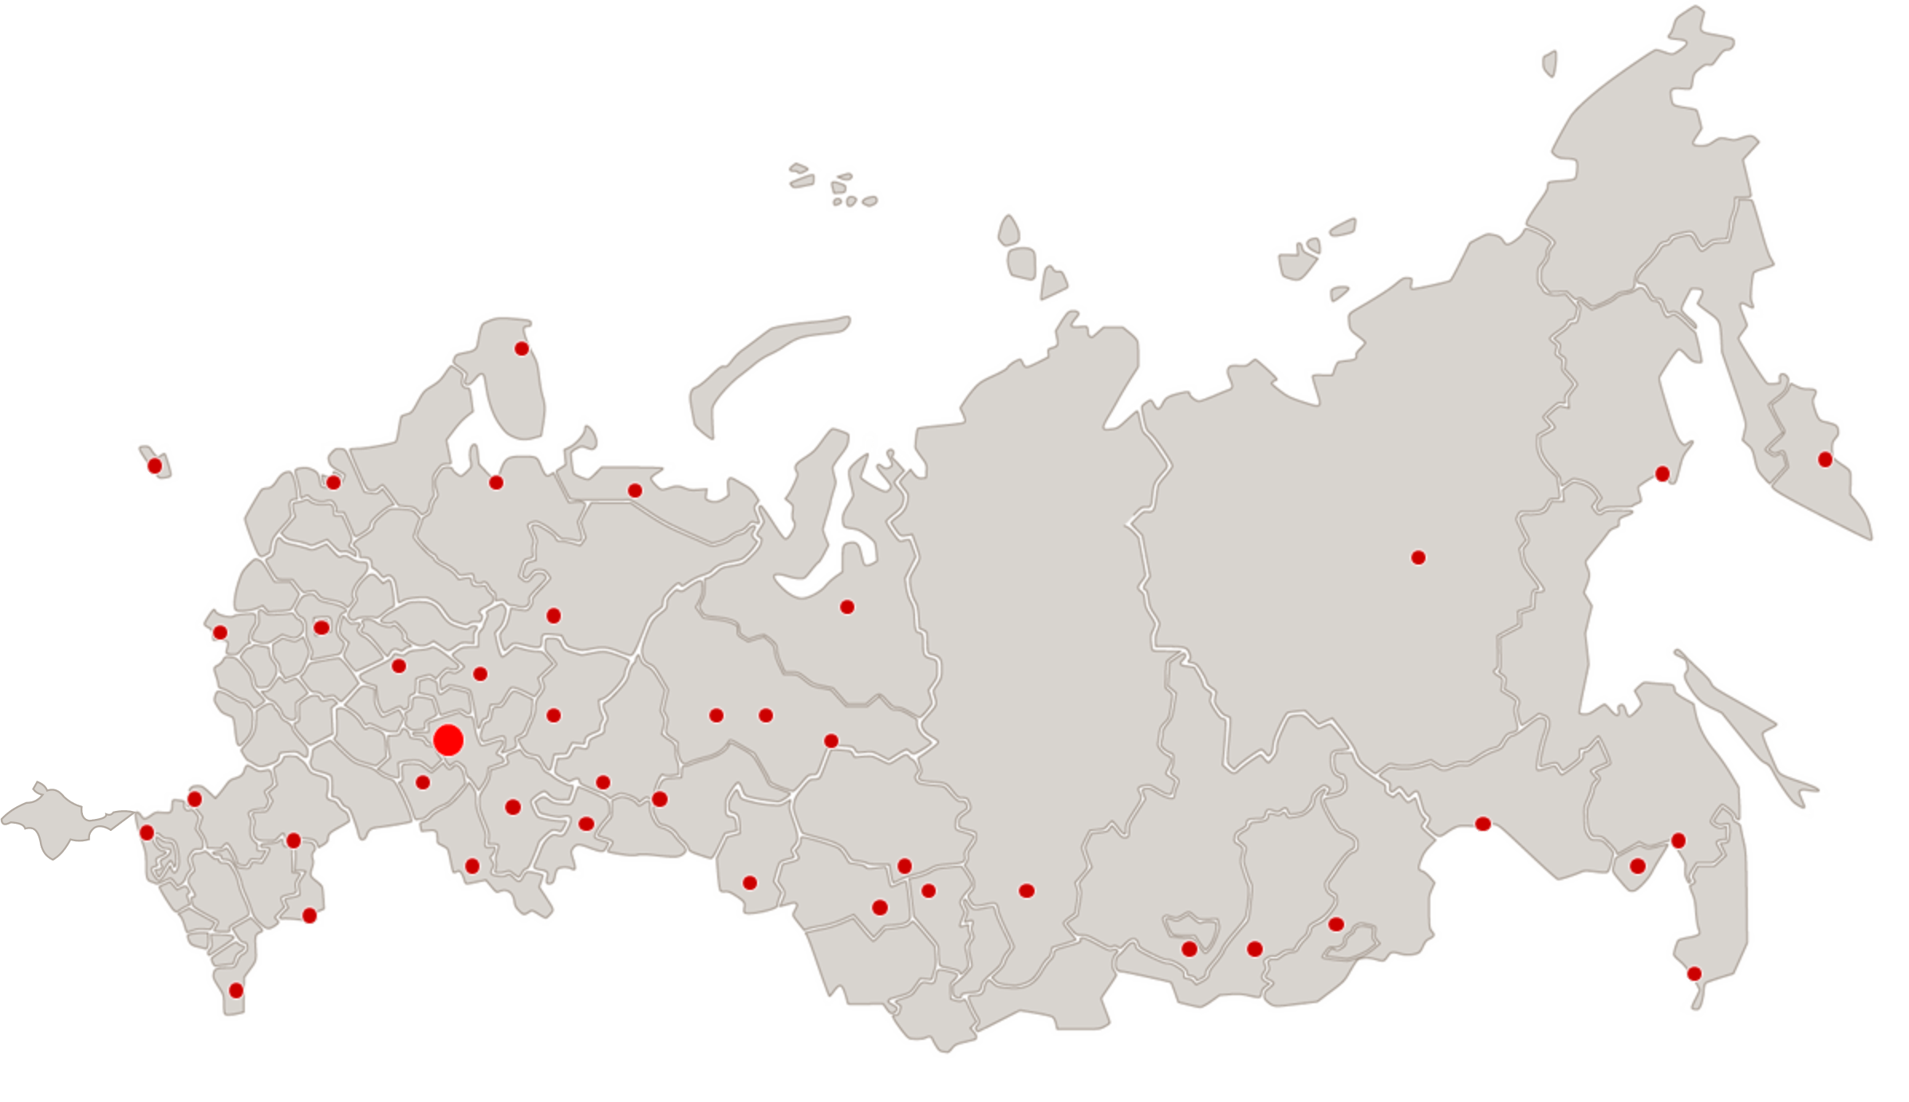
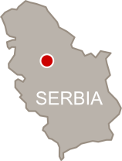
Global Footprint
95%
territory of Russia covered by ICL Group service centers
~2000
employees at the head office in Kazan
>130
regional service centers across Russia
OFFICES IN:
Moscow, St. Petersburg, Astrakhan,
Krasnodar, Voronezh, Belgrad
Murmansk
Belgrad
Petropavlovsk-Kamchatski
Kaliningrdad
Archangelsk
Magadan
St. Petersburg
Naryan-Mar
Yakutsk
Bryansk
Moscow
Syktyvkar
Novy Urengoy
Nizhny Novgorod
Kirov
Khanty-Mansiysk
Kazan
Perm
Surgut
Rostov-on-Don
Ekaterinburg
Novorossiysk
Voronezh
Ufa
Tyumen
Nizhnevartovsk
Blagoveshchensk
Volgograd
Samara
Tomsk
Khabarovsk
Chelyabinsk
Astrakhan
Orenburg
Omsk
Krasnoyarsk
Chita
Biribidzhan
Novosibirsk
Kemerovo
Irkutsk
Vladivostok
Makhachkala
Ulan-Ude

Slide 4





Awards
1
HARDWARE
according to Expert RA
of Russia’s largest IT Hardware Manufacturers
7
IT SERVICES
IN TOP
according to CNEWS
In the ranking of the largest providers of IT-outsoursing in Russia
10
IT SECURITY
IN TOP
according to Expert RA
the largest Russian IT companies
in Information Security
10
IT-outsourcing
IN TOP
according to
Gartner
Russian IT outsourcing Providers
IN TOP
according to RIA Ranking
20
INFORMATION TECHNOLOGY
the largest IT companies in Russia
100
IT-outsourcing
IN TOP
according to
IAOP®
Global Outsourcing Providers
Notes:
1st place of Russia’s largest IT Hardware Manufacturers
7th place In the ranking of the largest providers of IT-outsoursing in Russia
9th the largest Russian IT companies in Information Security
12th place in the ranking of largest IT providers in Retail
16th place in the ranking of largest IT consulting providers
17th place in the ranking of largest IT providers in Government
38th place in the ranking of largest IT providers in Banking
40th the largest IT companies in Russia

Slide 5


















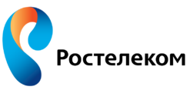










Key customers
PUBLIC SECTOR
MINISTRY OF EDUCATION AND SCIENCE
RUSSIAN POLICE
MINISTRY OF HEALTHCARE
EMERCOM
FINANCE
RETAIL
Transport & Logistics
TELCO
INDUSTRY
FUEL & ENERGY
* A few companies on the slide are Fujitsu Group customers being served by ICL Group

Slide 6
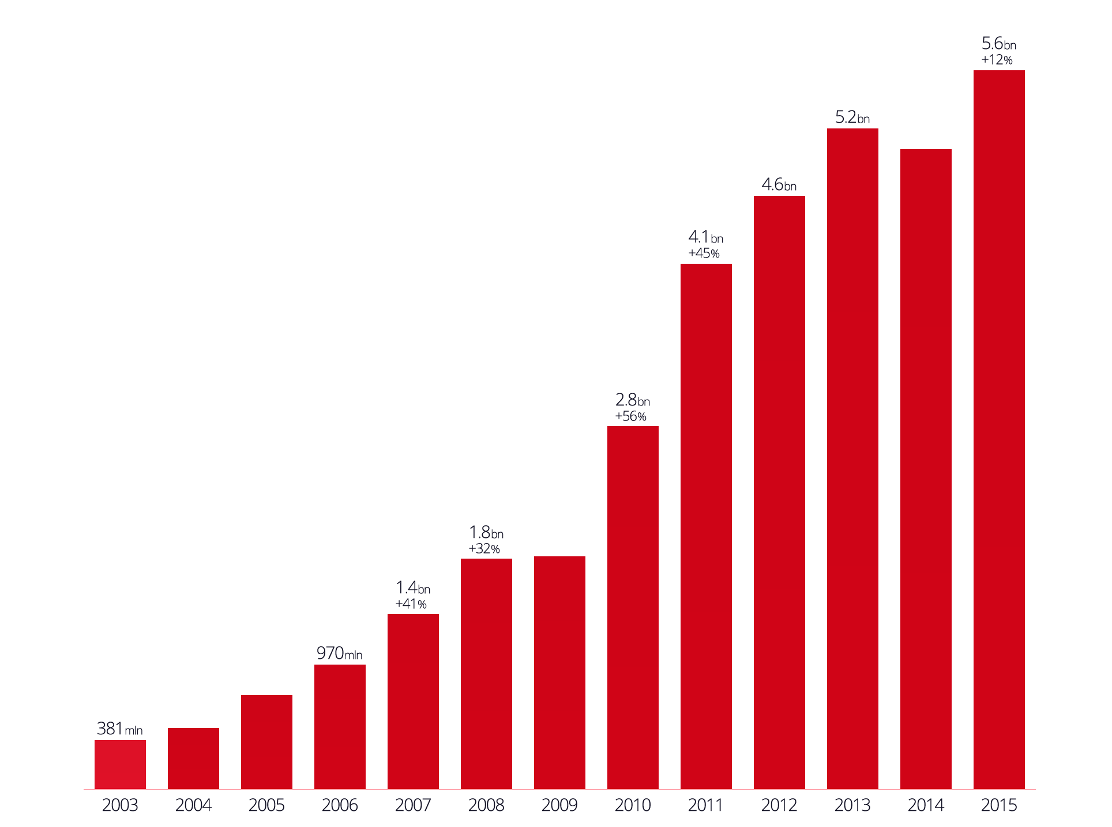
Company Growth in 2003–2015 (RUR)
5 161 795
4 632 596
4 105 075
3 333 587
1 969 650
1 798 183
1 366 856
970 169
733 328
477 853
380 985

Slide 7
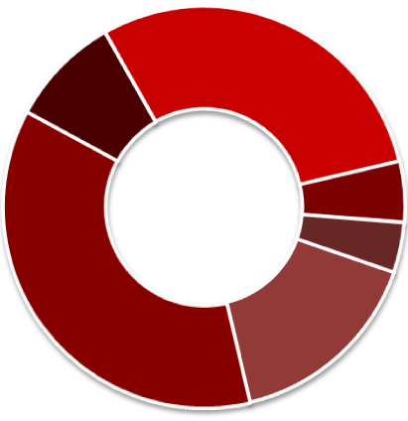
Business areas revenue split
Software Development and Implementation
IT Outsourcing
30%
9%
Engineering (5%)
Other (3%)
System Integration
37%
16%
Hardware Manufacturing

Slide 8
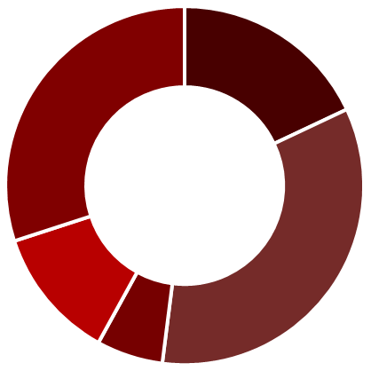
Revenue split by customer/region
18%
Republic of Tatarstan
Foreign Customers
30%
34%
Russian Federation
12%
Gazprom
7%
Power-wielding structures

Slide 9
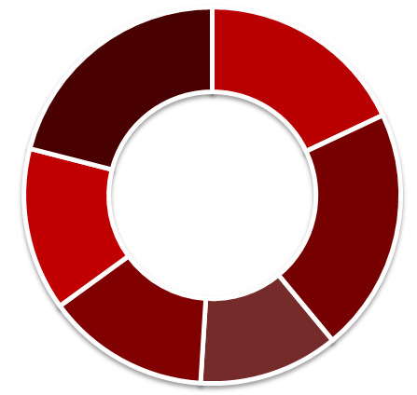
Revenue split by industry sectors
Other
Public Sector
21%
18%
Finance
14%
21%
Energy and Fuel
14%
12%
Retail
Manufacturing

Slide 10
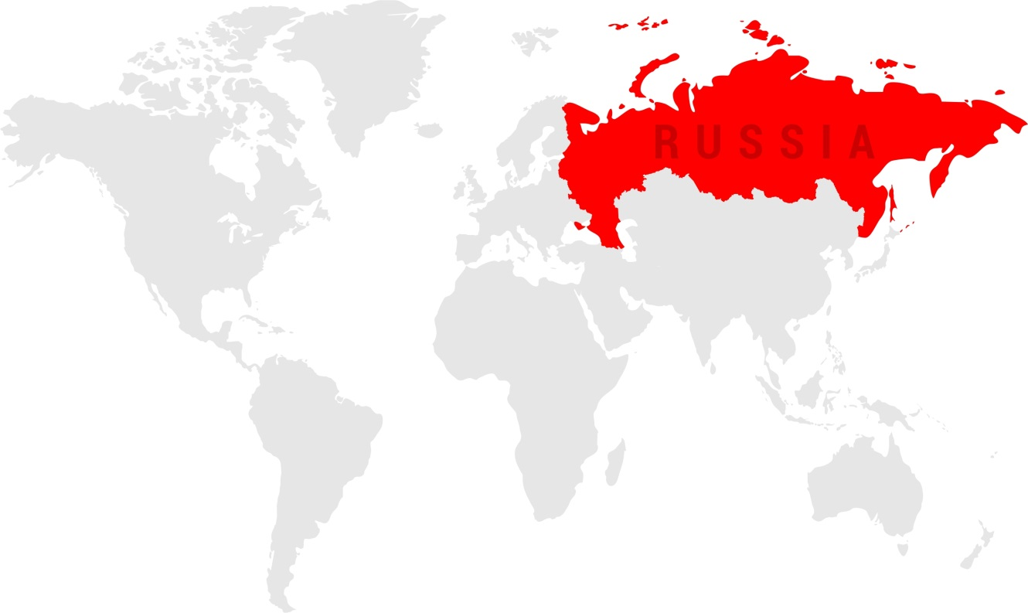
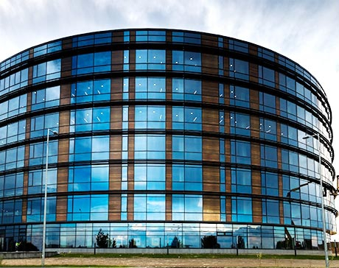
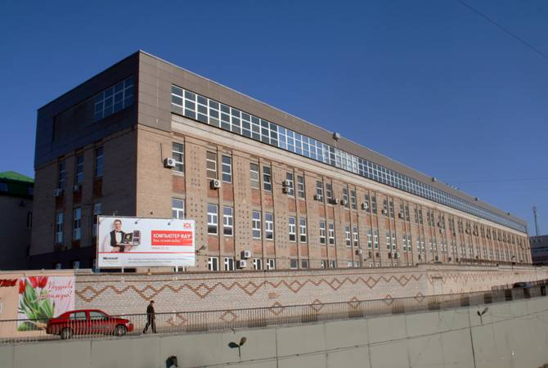
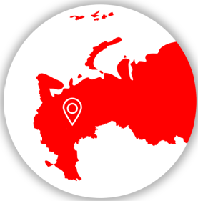
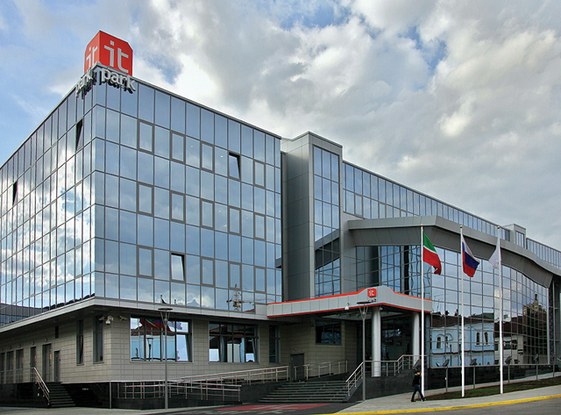
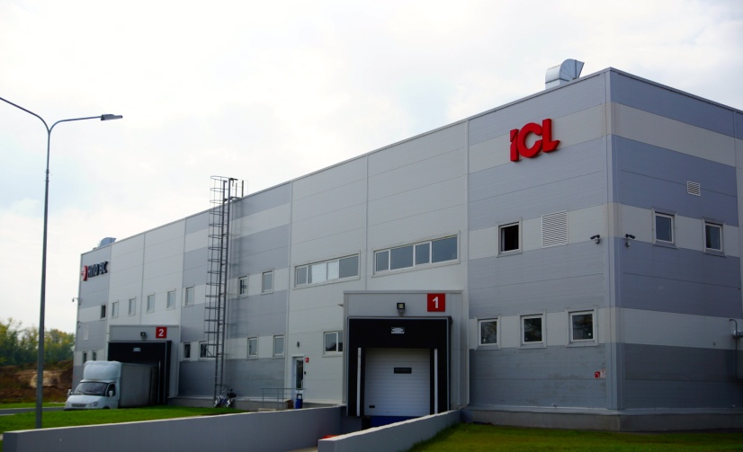
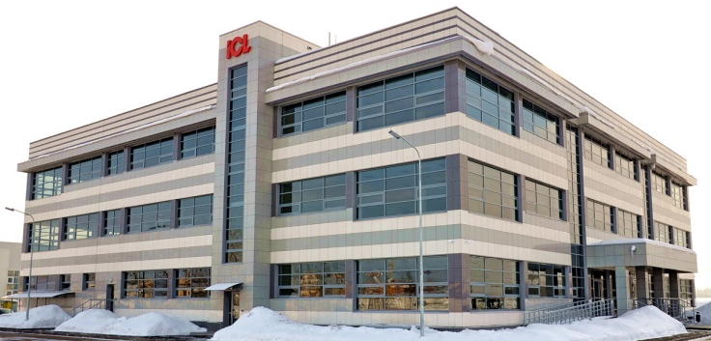
Offices and Facilities in Kazan and suburbs
Innopolis
Kazan
ICL Main office, Kazan
IT Park, Kazan
ICL new Office building, Innopolis Laishevo
ICL Assembly Plant, Innopolis Laishevo
Notes:
1. Russia GDC тесно интегрировано в структуру деливери центров FJ и работает под управлением GFA, определяющее политики соответствия требованиям FJ (compliance requirements confirmation) и политики корпоративной социальной ответственности (Corporate social responsibility).

Slide 11
Portfolio
Managed Infrastructure
Application Services
Workplace application and testing services
Business & Industry Solutions
Bespoke and packaged Software
Full range of IT Services
Application Services & Business and Industry Solutions
IT outsourcing
Infrastructure
services
Hardware manufacturing
PCs, Laptops, Servers
PC based solutions
Maintenance
IT Infrastructure
IT Security
Personal data protection

Slide 12




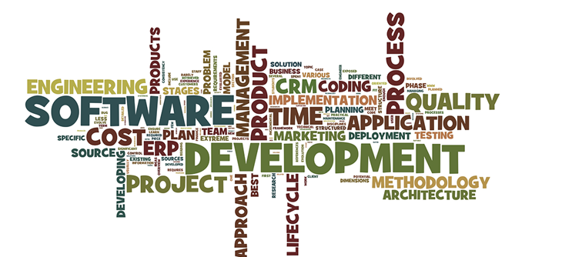
Application Services
Bespoke SW development
Packaged Solutions
Application Management
Information Management Solutions

Slide 13
Industry-Specific Solutions by Living Environment
Life Safety
AMS System 112
AMS System 01
Police Station
Front Office
AMS Road Police Station
Front Office
*
Health Care
AMS Ambulance
AIS Public Health Security
Housing &Public Utilities
Russian Billing Appliance
(Housing & Utilities module)
AMS
Dispatchers / Resource Suppliers
Agricultural Sector
IS Agro-Industrial Complex
Budget and Finance
IS Management Accounting
IS Procurement Management
Land and Property
Relations
AS Government & Municipal Property
Power Industry
Energy Systems Analysis and Design
using CYME solutions
Russian Billing Appliance
(Gas Accounting, Electricity Accounting modules)
Document Flow
Follow-up Control System
Electronic Document Archive System
Social Protection
IAS Panic Alarm Button

Slide 14







Business and Industry Solutions
ERP Solutions
Integrated CAD,CAM/ERP Solutions
Project Management
Business Consulting

Slide 15
























Infrastructure Services
IT Security
Personal Data Protection
IT Infrastructure
Technological Partners
Venue:
May 26-27, 2016
Kazan, Korston Hotel

Slide 16
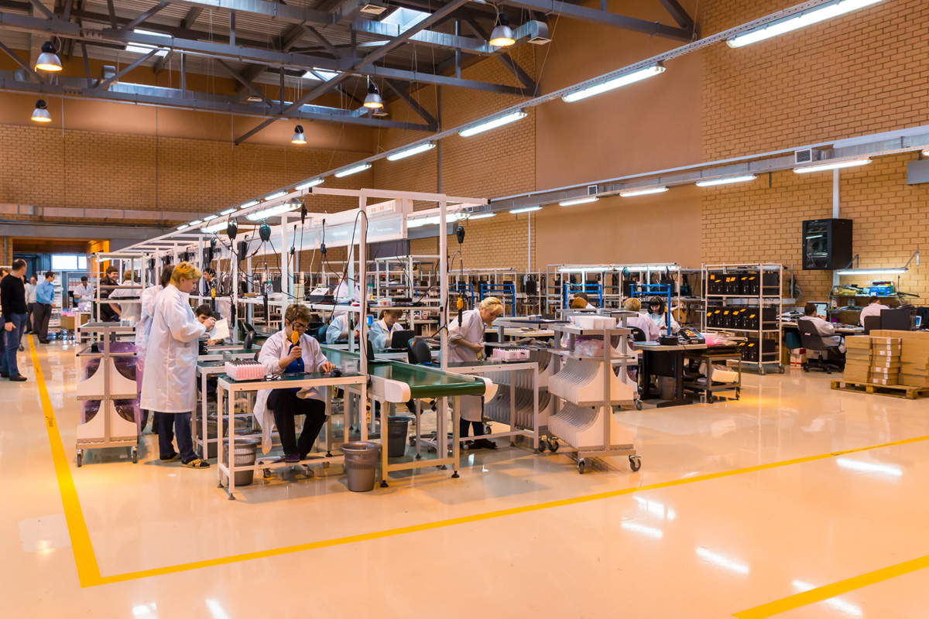
Hardware Manufacturing
Own Assembly Plant in Innopolis Laishevo
Production capacity up to 300,000 units per year
Meets standards
international ISO 9001-2011
Russian ГОСТ РВ 15.002-203
100% products maintenance all over Russia
Product list:
  Laptops
  Tablets
  All-in-One
  PCs
  Servers
  Thin clients
  PoS Stations
  Information Stations
  Self Checkout Terminals

Slide 17






IT outsourcing
Global Delivery Centre
SERVICES
Service Desk
Managed Infrastructure Services
Application Management Services
End User Services
QUALITY AND STANDARDS
CUSTOMER SUPPORT
EXPERTISE
  ISO 27001
  ISO 9001:2011
  ISO 20000
Retail
Logistics
Production
Finance
Government
Oil and gas
24x7 Russian,
English, French,
German
Background in working with the largest IT vendors and global customers
Use of modern methodologies and processes
Work with Fujitsu all over the world while providing services
Notes:
ISAE 3402 Type II
Альфия: срок действия сертификата истек в 2012 году
чем можем заменить?
гм. ничем... просто надо подумать, стоит ли в принципе указывать

Slide 18












IT outsourcing
Global Delivery Centre
250 business
applications are being supported
Over 50 clients in 26 European countries
11 petabytes
of data
Over 14 000 servers and network devices
5-7 years
services contracts
99.8% level of SLA compliance
Over 60 000 users around the world
Over 500 certifications
Over 60 IT services in
portfolio

Slide 19














Service Desk
Expertise and Services
  Provided Services
  Single point of contact for end users
  Call logging & dispatching, monitoring and SLA reporting
  Resolution of incidents over remote connection, by providing guidance to end users over phone and email
  Access rights management
  Inventory and metering of equipment and/or licenses
Service Desk covers
basic IT services
Languages
  General PC architecture support
  OS Microsoft XP/Vista/W7 and other standard software support;
  1st and 2nd line support for line of business COTS applications (SAP, Outlook, MS SharePoint и т.д.)
russian
tatar
english
turk
german
azeri
french
uzbek
* Majority of Customers listed on the slide are the clients of Fujitsu Group, with ICL Services (ICL Group company) providing services to it.

Slide 20



FIELD SUPPORT SERVICES
Expertise and Services
  OUR Services
Effective field support in Russia and in CIS countries
  Key benefits
Specialists are located in all regions of Russia
Wide range of supported hardware
Highly customizable service levels
Certified specialists for servicing the end user and datacenter hardware
Specialists who speak foreign languages
LINDORFF, TIKKURILA, ORION PHARMA, CPS COLOR, PEKKANISKA, RUUKKI
Russian Ministries and agencies
Locations: all overRussia
Shell
SLA: 24x7
servers rooms support
FUJITSU
Service partner:
SLA: 9х5, 24x7
for Fujitsu hardware products in Europe and Russia
Lufthansa
Location: Moscow, Saint-Petersburg, Kazan, Krasnoyarsk, Samara, Nizhny Novgorod, Yekaterinburg. SLA: 24x7
Finnish companies
SLA: 9x5, equipment support

Slide 21








REMOTE Infrastructure MANAGEMENT
Expertise and Services
  Coverage
  High quality, professional and secure 24x7 IT Infrastructure management services for global customers
  2nd and 3rd line support for the Dynamic Infrastructure Portfolio Elements
  Managed Data Center
    Managed Server (UNIX, WINTEL, E-Mail, Enterprise Management, Virtualization, Databases, IT security, etc)
    Managed Storage (NetApp, EMC, Backup/Recovery, etc)
    Managed Networks (LAN, WAN, VPN, DSL, Network Security etc)
  Managed Workplace (RDM, Software Delivery, Image Management, Application Packaging and Testing)
  Quality and Standards
  ISO 27001, ISO 9001:2011, ISO 20000 and ISAE 3402 Type II (SAS 70) accreditation for Infrastructure Services delivery
* Majority of Customers listed on the slide are the clients of Fujitsu Group, with ICL Services (ICL Group company) providing services to it.

Slide 22


















BUSINESS AND Application Services
Expertise and Services
Retail
Logistics
Mobile development
Business Automation
Application development and Integration
Application Management
  Bespoke development using Java (J2SE, J2EE, J2ME), Microsoft (MS .Net Framework, MOSS, MSF), Oracle (Oracle Database and Application Server, BI, Portal, SOA, BPEL, RAC).
  Application Integration using enterprise solutions (Sonic ESB, Sonic MQ, Apache Camel, MS BizTalk, Azure)
  Development for mobile platforms iOS, Android, WP (iOS SDK, Cocoa Touch, Objective-C, Android SDK, Windows Phone 7/8, Silverlight)
  Application testing - Dedicated Software Test Team: 30 FTE (ISEB and Microsoft certified)
  Application Support and Maintenance
  Application Re-design and reengineering, legacy modernization
Business Process Automation
  Automated process discovery
  ITSM consulting & automation (e.g. ServiceNow, OTRS)
  BP consulting & automation (e.g. Business Studio, Nintex)
* Majority of Customers listed on the slide are the clients of Fujitsu Group, with ICL Services (ICL Group company) providing services to it.

Slide 23














Consulting
Expertise and Services
Highly qualified consultants
Knowledge of the most common process modeling notations and data flows: IDEFx, eEPC (ARIS), CFF, BPMN 2.0, UML
Development of business requirements for ITSM systems: Service Now, BMC, HP SM, OmniTracker, Itiulium, etc. to OTRS-level Open Source systems
Deep expertise in ITSM: ISO20000, ITIL v.3 Expert, CobiT, MOF, ISO27001 and Process Mining certified experts
Extensive expertise in project and risk management at the corporate level (PRINCE2, M_o_R etc.)
Methodologies and best practices :
CMMI for Development, CMMI for Services
PMBok, PRINCE2
M_o_R
OBASHI, TOGAF
ITIL v.3 2011 edition
MOF
CobiT v.4, v.5
ISO 20000-1, ISO 27001, ISO19011
Six Sigma, Lean, 5S
Process Mining
TIPA
ABC of ICT

Slide 24
Thank you

