Slide 1
POLYMER MATERIALS
PJSC «NIZHNEKAMSKNEFTEKHIM».
PRODUCTION AND INNOVATION
Business Forum
“Tatarstan – Japan: Investment Future”
D.A. Maksimov, M.G. Fatyhov
PJSC «Nizhnekamskneftekhim», Nizhnekamsk, Russia
August, 2016
Kazan

Slide 2
NIZHNEKAMSKNEFTEKHIM TODAY
9 Plants
Butyl Rubber Plant • Ethylene Plant
7 Administrations
Railway Transportation • Chief Metrologist Administration
7 Centers
Research & Technology Centre • Automation Centre
Synthetic Rubber Plant • Ethylene Oxide Plant
Plastic Plant • Styrene & Polyether Resin Plant
Oligomer Plant • Isoprene Monomer Plant
Engineering Supervision • Power Supply
Water Supply, Sewerage and Wastewater Treatment • Social Development
Design Centre • Welding Centre
Technical Diagnostics & Residual • Publishing & Polygraphic Centre
Operating Life Centre
Power Plant
Divinyl & Hydrocarbon Feed Plant
Training Centre
2

Slide 3
CURRENT PRODUCTION STATE
Description | 2014 | 2015 | 2016 (forecast)
Synthetic Rubbers, kt
Isoprene | 253 | 266 | 288
Butyl (including IIR, BIIR, CIIR) | 200 | 198 | 200
Butadiene (including PBR-Nd, PBR-Li/SSBR) | 164 | 183 | 196
3

Slide 4
CURRENT PRODUCTION STATE
Description | 2014 | 2015 | 2016 (forecast)
Plastics, kt
Polyethylene | 204 | 200 | 200
Polypropylene | 213 | 213 | 210
Polystyrene (including general-purpose polystyrene (GPPS), high-impact polystyrene (HIPS), ABS plastics) | 298 | 305 | 300
4

Slide 5
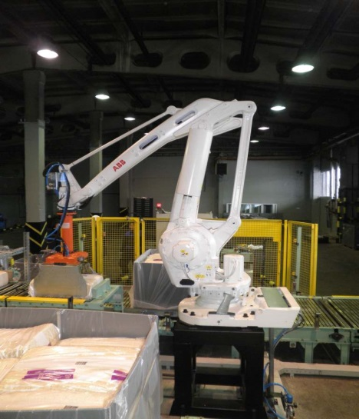
ISOPRENE RUBBER
Overview of the production and the product:
Technology developed by FGUP NIISK (USSR).
Design production capacity 240 kta.
Application: production of tires. It is also used in the production of rubber technical goods, rubber footwear, sports equipment, adhesives and water-repellant compounds.
Benefits:
Uniqueness of properties of isoprene rubber produced by PJSC«Nizhnekamskneftekhim» is in low content of gel fraction and high content of cis-1,4 units (min 96%).
Development prospects:
Expansion of capacity up to 330 kt/a.
5

Slide 6
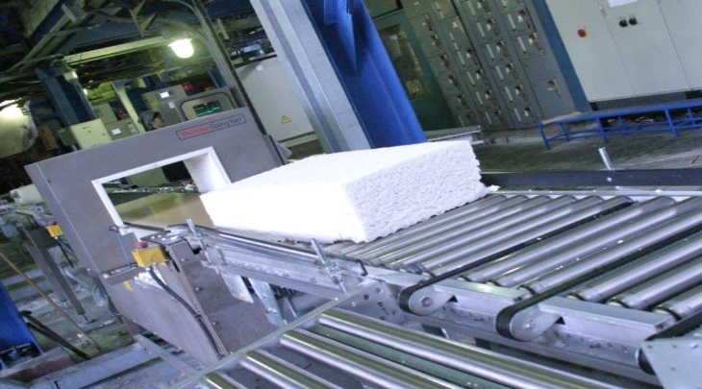
BUTYL RUBBER
Overview of the production and the product:
Butyl rubber technology developed by NII Yarsintez (USSR).
Design production capacity 35 kta.
HIIR technology developed by ООО Yarsintez (RF).
Design production capacity 30 kta.
Application: production of tires.
Intended for the production of an innerliner of tubeless tires, inner tubes, shaper vulcanizer diaphragms. It is also used for the production of medical and food purpose goods.
Benefits:
Narrow molecular weight distribution of butyl and halobutyl rubbers of PJSC «NKNK» is one of the reasons of higher gas tightness in comparison with competitive rubbers with the same initial properties.
Development prospects:
Increase of a share of halobutyl rubbers in the total production of butyl rubbers, increase of production capacity up to 220 kta.
6

Slide 7
DYNAMICS OF PRODUCTION
OF BUTYL RUBBERS (KT)
7

Slide 8
BUTADIENE RUBBERS
Overview of the production and the product:
PBR-Nd technology developed by FGUP NIISK (RF), brought into operation in 2004. Design production capacity 40 kta.
PBR-Li technology developed by R&D Center of PJSC «NKNK», brought into operation in 2007. Design production capacity 40 kta.
Application of PBR-Nd: production of tires and rubber technical goods.
Application of PBR-Li: styrene plastics modification to add impact value.
Benefits:
There are no oligomers and transition metals. High regularity and linearity of the polymer chains for PBR-Nd. Low concentration of gel fraction and color for PBR-Li.
Development prospects:
Development of PBR-Nd and SSBR technologies of new generation for the production of “green” tires, increase of production capacity up to 300 kta.
8

Slide 9
DYNAMICS OF PRODUCTION
OF BUTADIENE RUBBERS (KT)
9

Slide 10
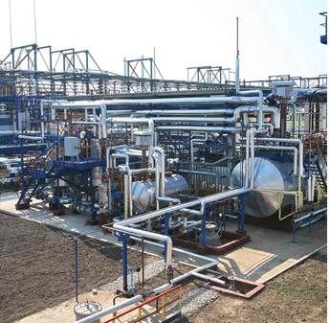
POLYSTYRENE
Overview of the production and the product:
Polystyrene is produced on three lines based on FINA TECHNOLOGY (USA) technology and one line under the license of TOYO-MITSUI (Japan). Design capacity of the plants is 240 kta.
Application: production of goods of technical and household applications by injection molding, extrusion, co-extrusion and thermal molding, including manufacturing of food packages and toys
Benefits:
Wide range of produced grades, 25 grades of GPPS and 6 grades of HIPS brought into production. Stable and high-quality product, low concentration of residual monomer in finished products.
Development prospects:
Grade diversification
10

Slide 11
ABS PLASTICS
Overview of the production and the product:
ABS plastics are produced based on the technology of Polimeri Europa, currently Versalis (Italy). Design plant capacity 60 kta.
Application: production of automotive components, household equipment items, toys, sports, medical equipment and products that come into contact with foodstuff.
Benefits:
Product range includes 9 grades of natural ABS plastic. Minimum amount of additives, polymer is free of acidic impurities, high thermal stability during processing. Main raw materials with the exception of acrylonitrile included into the range of products produced by the company.
Development prospects:
Development of grades with improved characteristics, growth of ABS plastic competitiveness.
11

Slide 12
DYNAMICS OF PRODUCTION
OF STYRENE RUBBERS (KT)
12

Slide 13
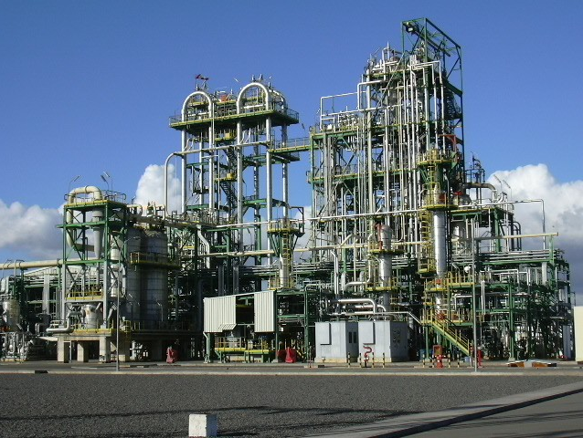
POLYPROPYLENE
Overview of the production and the product:
Spheripol technology by LyondellBasell (Italy).
Design production capacity 180 kta.
Application: production of automotive components,
tubes, containers, packages, films, filaments, fabrics, etc.
Benefits:
A wide range of polypropylene grades, Spheripol plant is capable of producing three types of polypropylene: homopolymers of propylene, random copolymers of propylene and ethylene, block copolymers of propylene and ethylene.
Development prospects:
Diversification of ethylene-propylene copolymer grades with improved impact properties.
13

Slide 14
DYNAMICS OF PRODUCTION
OF POLYPROPYLENE (KT)
14

Slide 15
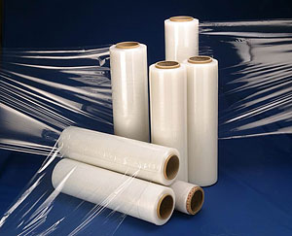
POLYETHYLENE
Overview of the production and the product:
Spherilene technology by LyondellBasell (Italy).
Design production capacity 230 kta.
Application: from the production of high strength tubular film, caps and covers to the production of large goods, pipes of small and large diameter.
Spherilene plant is capable of producing three types of polyethylene: of high, medium or low density.
Benefits: a wide range of grades, over 30 grades of HDPE, MDPE and LLDPE are offered to consumers. PJSC«Nizhnekamskneftekhim» is the only Russian producer of linear low density polyethylene.
Development prospects:
Grade diversification, including production and market development of polyethylene for steel pipes insulation.
15

Slide 16
DYNAMICS OF PRODUCTION
OF POLYETHYLENE (KT)
16

Slide 17
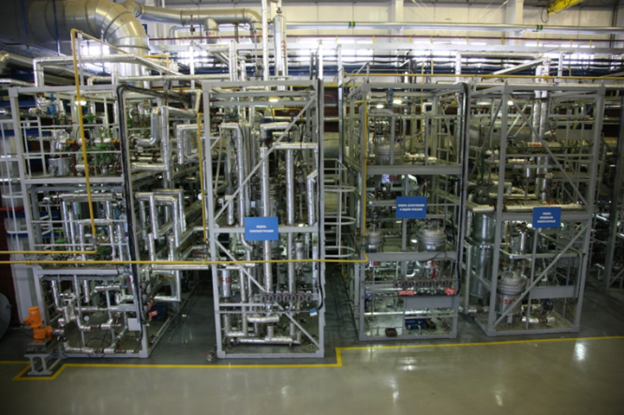
NEW SYNTHETIC RUBBERS
Pilot plant for producing elastomers – symbolizes a new age in development of new types of synthetic rubbers in PJSC «Nizhnekamskneftekhim». Unique equipment models all stages of industrial production of SR. Beginning from 2009, production technologies were developed and industrially introduced:
PBR-Li NDV
DSSK-2012
DSSK-2560F(M)
PBR-Nd
SSBR
new generation
17

Slide 18
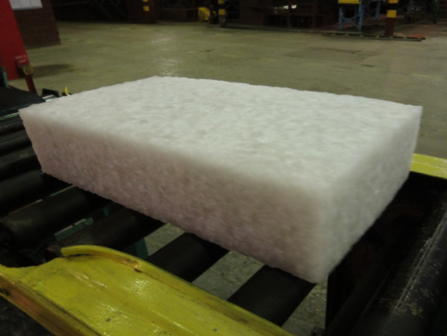
“NEODYMIUM” POLYBUTADIENE
FOR “GREEN” TIRES
“Neodymium” polybutadiene has a number of significant advantages in comparison with butadiene rubbers produced with other catalyst systems. Absence of oligomers, high stereoregularity and linearity of macromolecules, absence of transition metals.
Optimization of molecular structure and functionalization of polymer is still pending. Under laboratory and pilot conditions various methods of polymerization and functionalization have been proved. Composition of the catalyst has been optimized, and then PBR-Nd batches with improved characteristics have been produced under production-line conditions.
18

Slide 19
“NEODYMIUM” POLYBUTADIENE
FOR “GREEN” TIRES
Parameters | Standard | Improved
Mooney viscosity MB 1+4 (100° С) | 45,0 | 42,4 | 42,6
Cold flow, mm/h | 10,6 | 15,8 | 15,2
Mn × 10-3 Mw × 10-3 Mw/ Mn | 135 458 3,4 | 133 412 3,1 | 135 418 3,1
Hysteresis | 19,5 | 17,4 | 18,0
Payne effect | 290 | 218 | 230
tgδ at 60 ^{о}С | 0,201 | 0,177 | 0,178
Strength property, curing at T=145 °С ×35 min
Modulus 300 %, MPa | 8,5 | 10,9 | 11,2
Tensile stress at break, МПа | 12,7 | 13,2 | 13,3
Elongation at break, % | 400 | 380 | 380
Set after break, % | 12 | 8 | 8
Shore А hardness, un. | 55 | 56 | 57
Rebound resilience, % at curing 50 min
at 23 °С | 42 | 42 | 43
at 70 °С | 44 | 46 | 46
19

Slide 20
RESULTS OF TESTS OF TIRES WITH SIZE 195/55 R15 POLYGON IDIADA SPAIN
PARAMETERS | Type of Rubber
 | DSSK 2560 FM | Competitor
Evaluation of the performance of tires on the ride and handling
- direct motion | 7,5 | 7,4
- steering control characteristic | 7,0 | 6,8
- active safety (stability) | 6,6 | 6,3
- controllability on wet surface | 6,7 | 6,4
- ride comfort | 6,4 | 6,4
Total rating | 6,8 | 6,5
Evaluation of the performance of tires, noise
- noise level at tire-road contact, dB | 69 | 69
Evaluation of the performance of tires, braking path
- dry asphalt, m | 26,5 | 26,3
- wet asphalt, m | 36,9 | 37,9
20

Slide 21
QUALITY INDICATORS
DSSK-2560F AND DSSK-2560FM
Parameters | DSSK-2560F |  | DSSK-2560FM
 | I | II | 0 | I | II
Mooney viscosity MB 1+4 (100° С), within | 45-54 | 55-65 | 35-44 | 45-54 | 55-65
2. Viscosity spread within a batch, max | 6 |  | 6
3. Ash, %wt, max | 0,50 |  | 0,50
4. Weight loss at drying, %, max | 0,70 |  | 0,70
5. 1,2-bonds (in terms of butadiene share), %wt, within | 60 ± 5 |  | 60 ± 5
6. Bound styrene, %wt, within | 25 ± 2 |  | 25 ± 2
7. Oil, type: TDAE, %wt, within | - |  | 27 ± 2
21

Slide 22
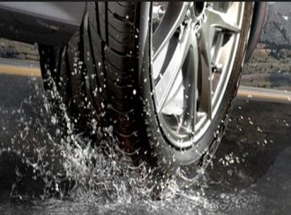
NEW GENERATION DSSK
In order to maximize tire performance characteristics, first of all, low rolling resistance, high wet grip, and low wear new generation DSSR is developed.
Pilot samples of new generation DSSR are already on testing at leading foreign and domestic tire companies.
22

Slide 23
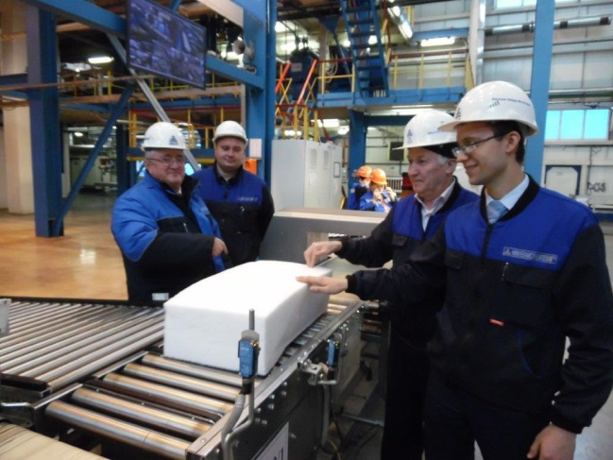
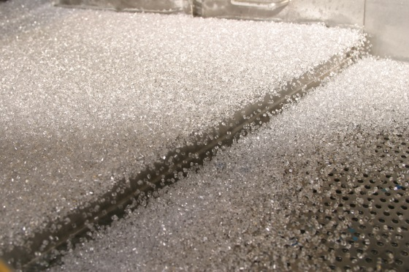
RUBBERS FOR STYRENE PLASTICS MODIFICATION
In 2007, PBR-Li technology was just under development, then in 2008, “lithium” polybutadiene of required quality was fully provided for the production of polystyrene of PJSC «Nizhnekamskneftekhim».
In 2012, it was decided to develop block divinyl-styrene elastomer technology.
In 2013, pilot testing was carried out and more than 3000 t of new type rubber was produced. Currently, unique elastomer DSSK 2012 is recommended for constant industrial use during ABS plastics production.
23

Slide 24
QUALITY INDICATORS
DSSK 2012
Parameter | Norm per groups
 | I | II
1. Mooney viscosity MB 1+4 (100 оС), within | 30-70
2. Viscosity spread within a batch, un., max | 6
3. Ash, %wt, max | 0,10
4. Weight loss at drying, including moisture, %, max | 0,60
5. Gel (5,43 % as mass of rubber solution in toluene), %wt, max | 0,020
6. Viscosity (5,43 % as mass of rubber solution in toluene), mPa∙s, within | 15 – 30 | 30 – 45
7. Color according to platinum cobalt color scheme (5,43 % as mass of rubber solution in toluene), max | 10
8. 1,2-bonds, %wt, within | 10-16
9. Styrene, %wt, within | 15 – 25 | 5 – 15
24

Slide 25
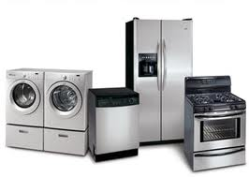
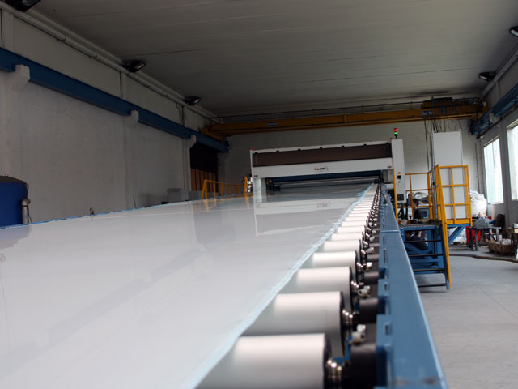
ABS PLASTICS BASED ON DSSK-2012
Development of DSSK-2012 in the production of ABS plastics went through several stages. At the first stage grades of plastics intended to be processed by extrusion method were developed. At the second stage DSSR-2012 was developed with a complex of properties that can be used in the production of injection molding grades of ABS plastics.
At the present time research works in this field are going on. An interesting idea is to use rubber compositions with different properties. One of the tasks here is enhancing impact properties of ABS plastics while maintaining a complex of polymer application properties.
25

Slide 26

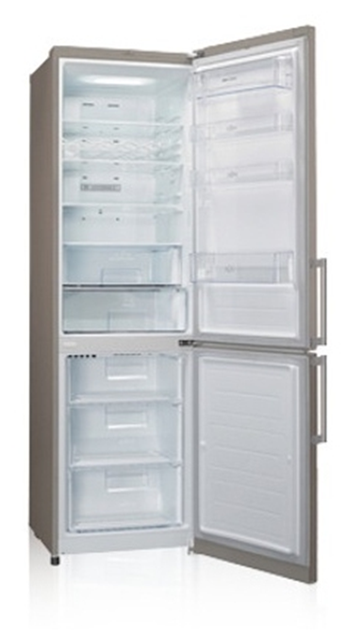
HIGH-IMPACT POLYSTYRENE WITH ENVIRONMENTAL STRESS-CRACKING RESISTANCE (ESCR)
Development of a wide range of synthetic rubbers for plastics modification was followed by research works to produce polystyrene grades with new properties. One of such examples can be high-impact polystyrene with environmental stress-cracking resistance (ESCR).
On an industrial scale the first test stage was successfully completed. Oil-grease resistant grade HIPS 825 ESM was produced. Tests performed at consumers, including Pozis company, showed significant enhancement of environmental stress-cracking resistance of polymer in comparison with standard products.
26

Slide 27
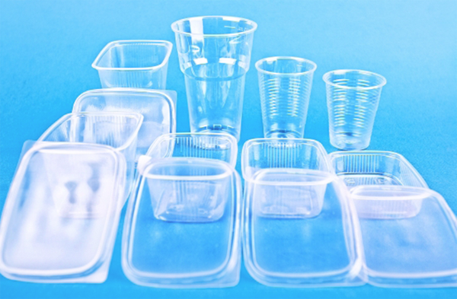
NEW POLYPROPYLENE GRADES
Main course of research works is development of a technology that allow produce new grades of ethylene-propylene copolymers. Generally, it’s import-substituting grades of polypropylene. Such materials are ordered by – manufacturers of car components, high-integrity, freeze-resisting containers of various shapes and sizes and packages.
homo-PP
random PP
Industrial tests are actively carried out. Beginning just from 2014, more than 5 new grades of random and block copolymers have already been developed and brought into production. New random copolymers have advanced processability, as well as organoleptic and optic properties. As for block copolymers, at the same time high values of impact resilience and flexural modulus have been reached.
27

Slide 28
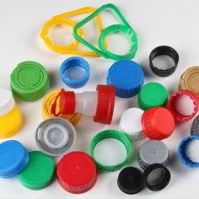
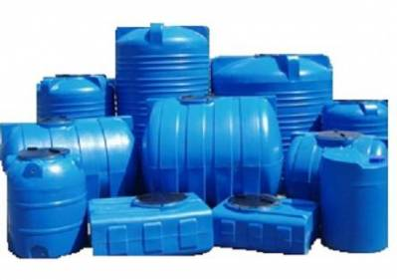
NEW POLYETHYLENE GRADES
…unique in RF.
High density polyethylene grade РЕ 6054Р/6052P for the production of caps and covers. A distinguishing feature of the plastic is unique macromolecular structure that provide increased cracking resistance.
Middle density polyethylene grade РЕ 6438R for processing by rotational molding method. Tests have been successfully performed at consumers during manufacturing of large containers (up to 10 m³) of complex structure.
28

Slide 29
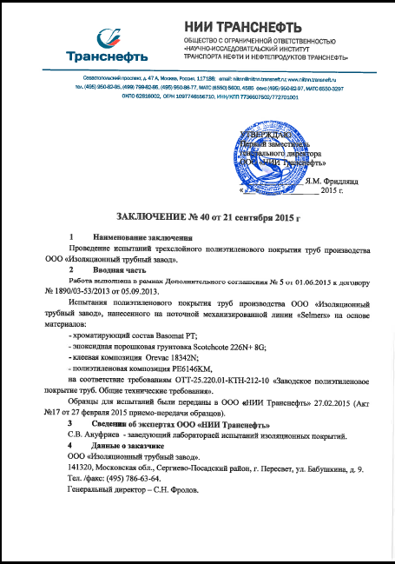
POLYETHYLENE PE 6146КМ
FOR INSULATION OF GAS AND OIL PIPELINES
Starting from 2014, a distance from laboratory studies to industrial production of polyethylene composition РЕ 6146КМ was covered. Positive conclusions from NII TRANSNEFT were received, works with laboratory GAZPROM-VNIIGAZ are in progress. Currently, the product is actively introduced in the leading pipe plants of RF. In 2016, in RF production and consumption of more than 10 kt of new grade of polyethylene PE 6146KM is planned.
29

Slide 30
THANK YOU FOR YOUR ATTENTION!
Denis Aleksandrovich Maksimov,
Deputy Chief Process Engineer
PJSC «Nizhnekamskneftekhim»,
tel. (8555) 37-94-98
cell. +79872657936
E-mail: maksimovda@nknh.ru

