Slide 1
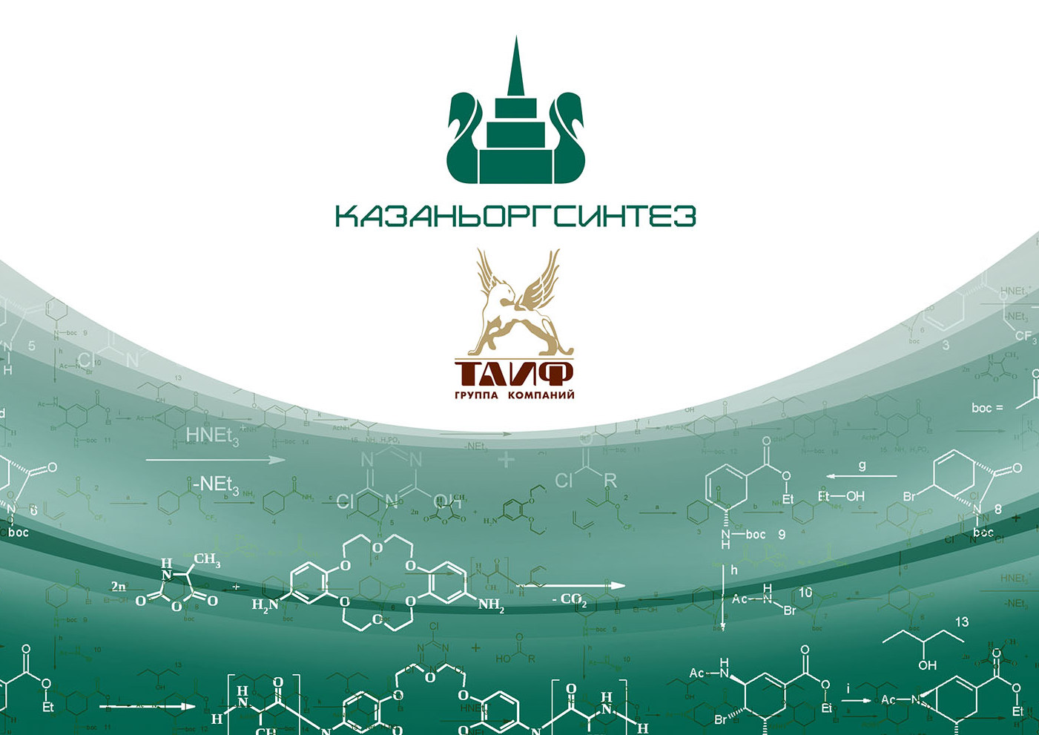



Slide 2

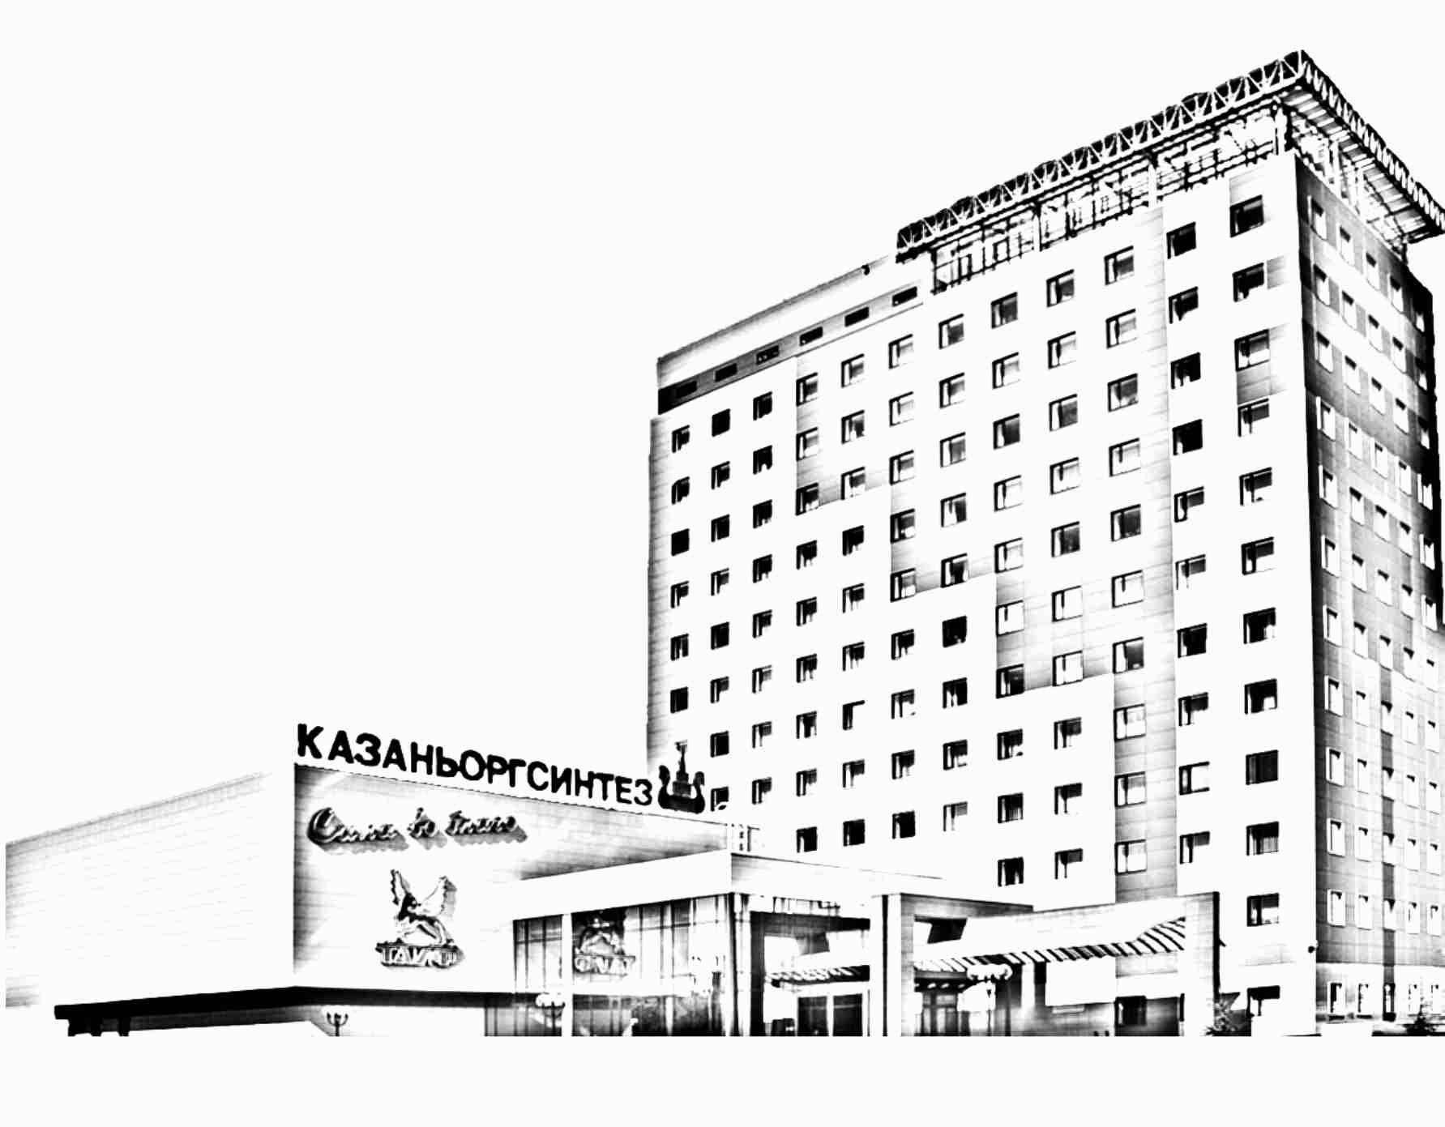
PJSC Kazanorgsintez is the largest domestic producer of polymers and ethylene copolymers, and the leading chemical enterprise in the Russian Federation. The Company is a part of TAIF Group of Companies.
PJSC Kazanorgsintez was founded in 1958, and its first batch of products (phenol and acetone) was produced in 1963. The Company makes about 1.5 million tonnes of products per year, which are sold in 30 countries worldwide.

Slide 3
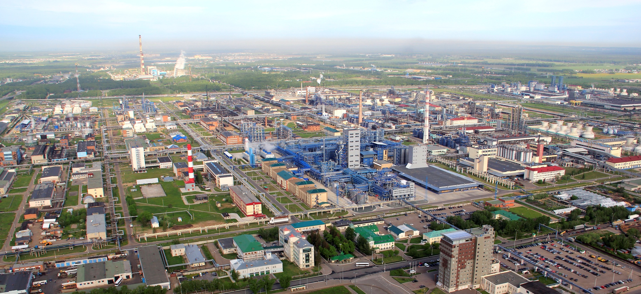
PJSC Kazanorgsintez is a production site with a total area of 4.2 square kilometres, having an integrated transport, energy and telecommunications infrastructure.
The Company includes seven interconnected production plants.

Slide 4
Production structure

Slide 5
Main types of the products being manufactured:
Ethylene
Sevilen
High and low density polyethylene, and compounds thereof
Bimodal polyethylene
Bisphenol A
Polycarbonates of optical, extrusion, molding grades
Pressure and gas polyethylene pipes and fittings
Phenol
Acetone
Ethanolamines
Ethyleneglycols
Textile-processing chemicals and modifiers
Oil demulsifiers
Butyl cellosolve
Liquid and gaseous oxygen for medical use
Gaseous nitrogen
Gaseous argon
Corrosion and paraffin inhibitors.

Slide 6
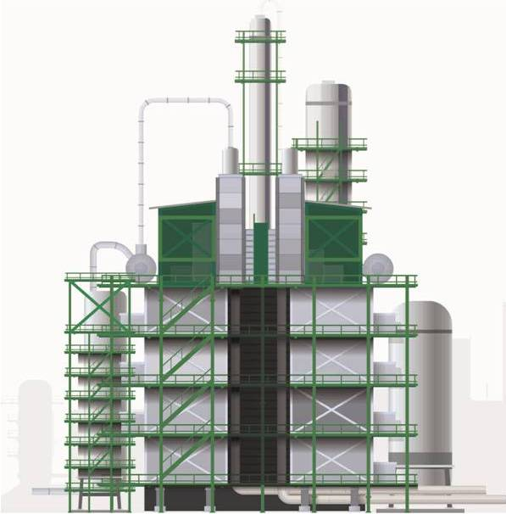
Ethylene Plant
Capacity is 640 KTA.
Output product:
propylene, butylene butadiene fraction, liquid cracking products, bottoms of the liquid cracking products, spent diesel fuel.

Slide 7
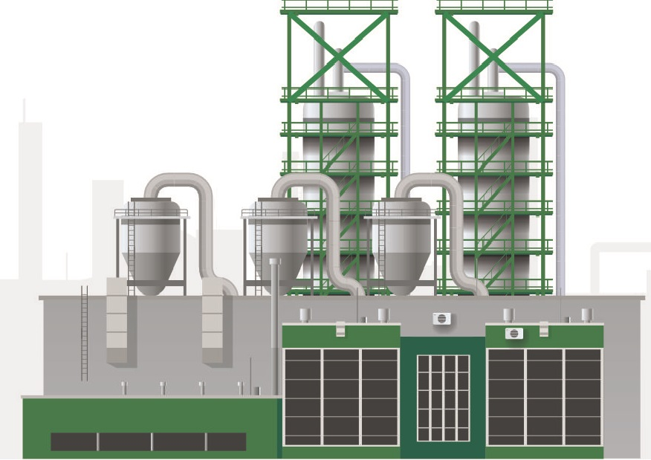
Plant for Production and Processing of High Density Polyethylene
Capacity is 510 KTA.
Output product:
Bimodal high density polyethylene, high density polyethylene and compounds thereof, sevilen, water and gas PE pipes and fittings.

Slide 8
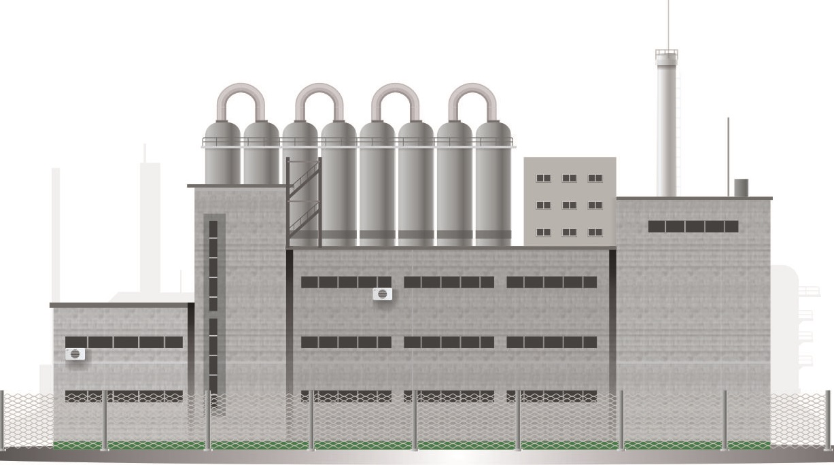
Low Density Polyethylene Plant
Capacity is 241 KTA.
Output product:
Low density polyethylene and compounds thereof.

Slide 9
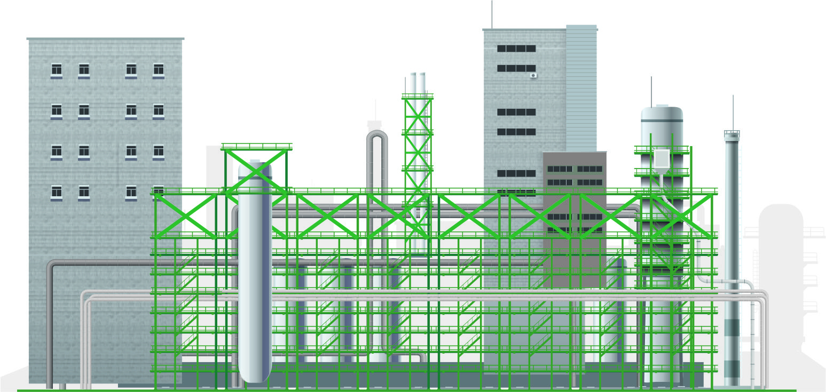
Polycarbonate Plant
Capacity is 66 KTA.
Output product:
Optical, extrusion and molding grade polycarbonates, ethyleneglycol

Slide 10
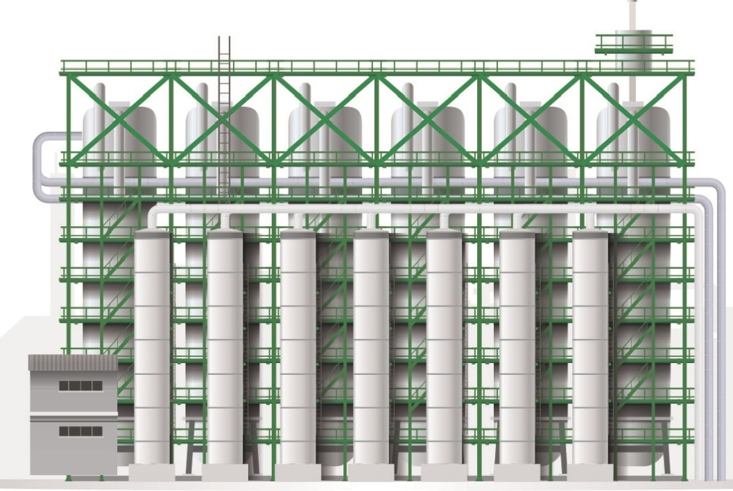
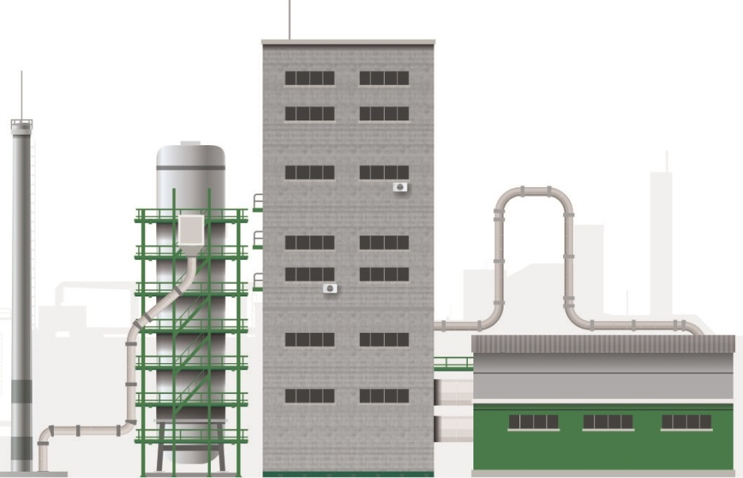
Bisphenol-A Plant
Capacity is 70 KTA.
Output product:
bisphenol-А (diphenylolpropane), phenol, acetone

Slide 11
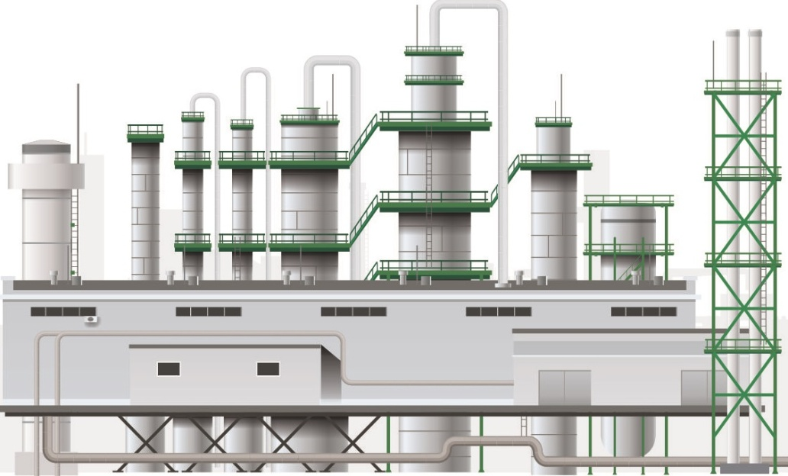
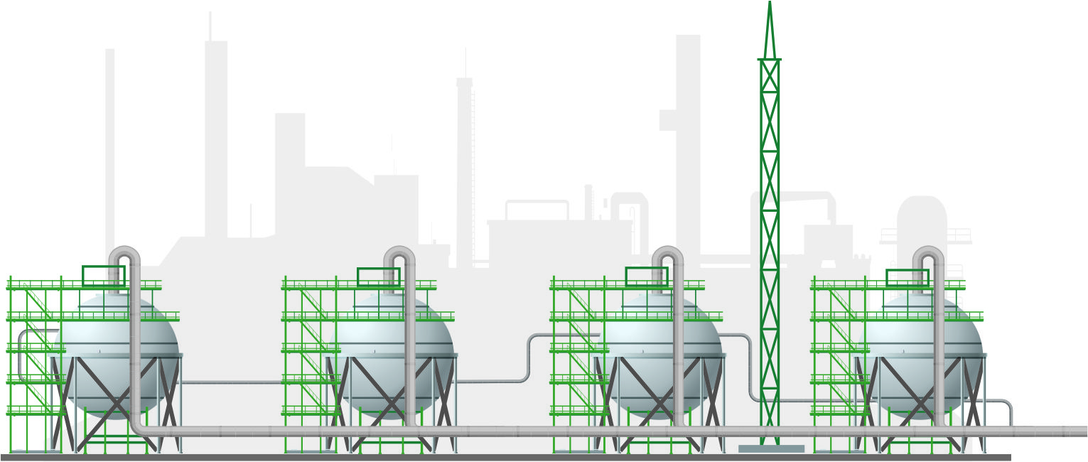
Organic Products and Industrial Gases Plant
Capacity is 16 KTA.
Output product:
ethanolamines, refrigerating liquid, textile-processing chemicals, dyproxamine, butyl cellosolve, demulsifiers, nitrogen, oxygen, argon, refrigerant and compressed air

Slide 12

Maintenance and Overhaul Plant
The Plant implements the process equipment preparation, and its routine maintenance and overhauling in all facilities of the Company

Slide 13
Belomorskaya st., 101
Kazan, 420051
Republic of Tatarstan, Russia
Email: kos@kos.ru
www.kazanorgsintez.ru

